Slide 1
CSE 165/ENGR 140 Intro to Object Orient Program
Lecture 2 – Programming in C++

Slide 2
Announcement
Lab #1
9/9
Reading assignment
Ch. 3, Vol. I

Slide 3
(Review) Object oriented programming
Everything is an object, along with its properties/attributes (i.e., variables) and methods (i.e., functions)
A program is a bunch of objects telling each other what to do by sending message
Objects of the same type can receive the same message
Each object has its own memory made up of other objects
Every object has a type, e.g., int, float, double, char, string

Slide 4
Declaration vs. Definition
Declaration
Gives a name (identifier) to a variable or function
Variable: extern int a; //extern means the variable will be defined later.
Function: int func(int, int);
Definition
Allocates a memory location (storage) for a variable or function
Variable: int a; int a = 1;
Function: int func(int length, int width) {…};
Illegal to define a variable or function multiple times in a program
Definition and declaration can take place at the same time in C/C++.

Slide 5
Declaration vs. Definition
//: C02:Declare.cpp
// Declaration & definition examples
extern int i; // Variable declaration
float f(float); // Function declaration
float b; // Declaration & definition
float f(float a) { // Definition
return a + 1.0;
}
int i; // Definition
int h(int x) { // Declaration & definition
return x + 1;
}
int main() {
b = 1.0;
i = 2;
f(b);
h(i);
}

Slide 6
Workflow of Compiling C++ Code
The compiler on your system converts the source code to object code: (xxx.cpp) -> (xxx.o/xxx.obj)
The linker combines all the object code into an executable program. (xxx.o, yyy.o, zzz.o) -> (a.out)
Examples
Compile and link: g++ hello.cpp –o hello
Compile only: g++ -c hello.cpp
Link only: g++ hello.o -o hello

Slide 7
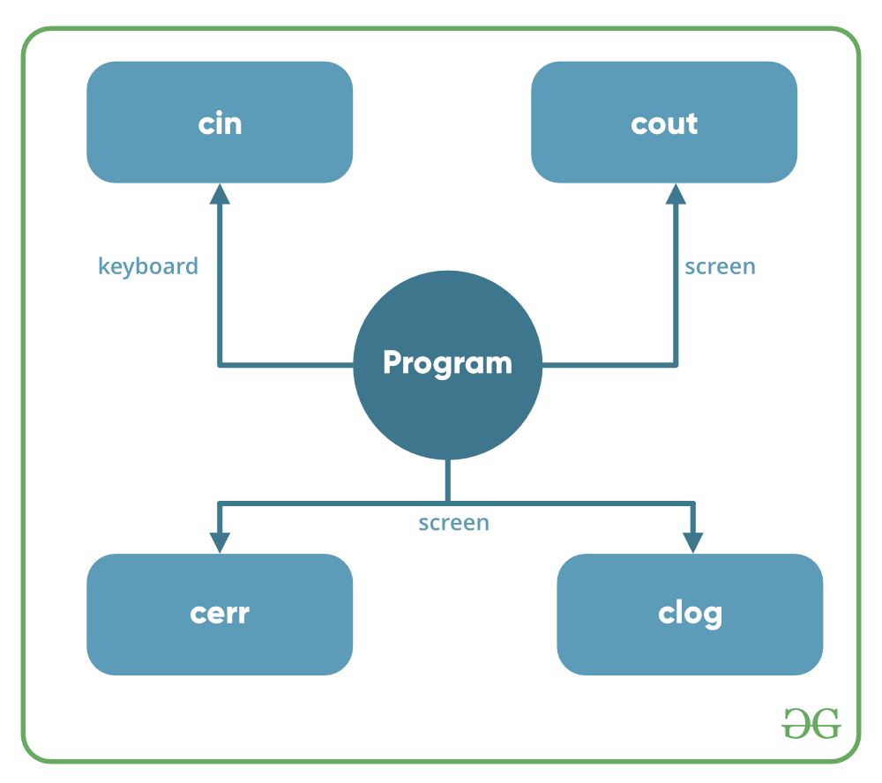
First Program: Hello World!
#include <iostream> // Input-output stream declarations
using namespace std;
int main()
{
int class_num = 165;
cout << "Hello, world!\n";
cout << "Welcome to CSE ";
cout << class_num;
return 0;
}
standard input stream
standard output stream
standard output stream for errors
standard output stream for logging

Slide 8
More about iostream
//: C02:Stream2.cpp
#include <iostream>
using namespace std;
int main() {
// Specifying formats with manipulators:
cout << “15 in decimal: "
<< dec << 15 << endl;
cout << "in octal: " << oct << 15 << endl;
cout << "in hex: " << hex << 15 << endl;
cout << "non-printing char (escape): "
<< char(27) << endl; // 27 is the ascii of “escape”
}
We can display integers in different bases:
Output:
15 in decimal: 15
in octal: 17
in hex: f
non-printing char (escape): ←

Slide 9
Reading Input (Cont.)
//: C02:Numconv.cpp
#include <iostream>
using namespace std;
int main() {
int number;
cout << "Enter a decimal number: ";
cin >> number; //Read input from user
cout << "value in octal = 0"
<< oct << number << endl; // endl: newline
cout << "value in hex = 0x"
<< hex << number << endl;
}
Output:
Enter a decimal number: 128
value in octal = 0200
value in hex = 0x80

Slide 10
String Class
Allows you to manipulate an array of characters
Needs to be included at the beginning of a program
//: C02:HelloStrings.cpp
#include <string>
#include <iostream>
using namespace std;
int main() {
string s1, s2; // Empty strings
string s3 = "Hello, World."; // Initialized
string s4("I am"); // Also initialized
s2 = "Today"; // Assigning to a string
s1 = s3 + s4; // Combining strings
s1 += " 8 "; // Appending to a string
cout << s1 + s2 + "!" << endl;
}
Output:
Hello, World! I am 8 Today!

Slide 11
File Stream Class (Input/Output)
To read from or write to a file, we need to include a built-in system class
#include <fstream> // stream class to read/write from/to files
Before reading from a file, we need to define and open a file for reading
ifstream myfile(<file_name>); // stream class to read from file_name
Before writing to a file, we need to define and open a file for writing:
ofstream myfile(<file_name>); // stream class to write on file_name
Close the file after finishing the operations with it
myfile.close();

Slide 12
File Input (Read)
Once a file is opened, we can read the content by lines:
getline (myfile, line); // read the current line of “myfile” and save it into variable “line”. It discards the newline character at the end
After reading a line, getline will start at the next line when it is called again. You don’t need to increment the line number in your code
#include <string>
#include <fstream>
using namespace std;
int main() {
ifstream myfile("Scopy.cpp"); // Open for reading
string s;
while(getline(myfile, s)) // Discards newline char
cout << s << "\n"; // ... must add newline back
}

Slide 13
File Output (Write)
Once a file is opened, we can write the content to the file as if writing to console:
myfile << "Writing to file is similar\n";
#include <string>
#include <fstream>
using namespace std;
int main() {
ofstream myfile("Scopy.cpp"); // Open for writing
string s = "Hello, World.";
myfile << s;
}

Slide 14
File IO Example
//: C02:Scopy.cpp
#include <string>
#include <fstream>
using namespace std;
int main() {
ifstream in("Scopy.cpp"); // Open for reading
ofstream out("Scopy2.cpp"); // Open for writing
string s;
while(getline(in, s)) // Discards newline char
out << s << "\n"; // ... must add newline back
}

Slide 15
File IO Example
//: C02:FillString.cpp
// Read an entire file into a single string
#include <string>
#include <iostream>
#include <fstream>
using namespace std;
int main() {
ifstream in("FillString.cpp");
string s, line;
while(getline(in, line)) // read a line
s += line + "\n"; // append to s
cout << s;
}

Slide 16
File IO Example
// Example using is_open
#include <iostream>
#include <fstream>
using namespace std;
int main () {
ifstream infile;
infile.open ("test.txt");
if (infile.is_open()) // Check if the file is open
{
while (!infile.eof()) // Check if it reaches the end of file
cout << (char) infile.get(); // Read character by character
infile.close();
}
else
{
cout << "Error opening file";
}
return 0;
}

Slide 17
Standard Template Library (STL) Vector
Provides programmers to store data effectively and do manipulation in stored data (more detail later in future lectures)
Works similarly as an array
elements in a vector of size N are accessed by their indices [0, …, N-1]
We can change the size of a vector dynamically
No need to worry about the size as data grows
A template class works with any data type
vector<int> myVector
vector<string> myVector
vector<double> myVector
vector<user_defined_data_type> myVector

Slide 18
Standard Template Library (STL) Vector
Member functions of STL Vector class (given a vector V):
resize(n): Resize V, so that it has space for n elements
size(): Return the number of elements in V
front(): Return a reference to the ﬁrst element of V
back(): Return a reference to the last element of V
push_back(e): Append element e to the end of V, thus increasing its size by one
pop_back(): Remove the last element of V, thus reducing its size by one
insert(i, e): Insert element e to the i^{th} position of V
erase(i): Remove the element at the i^{th} position of V
For more information, refer to https://www.cplusplus.com/reference/vector/vector

Slide 19
Vector Example
//: C02:Fillvector.cpp
// Break a file into line-separated sentences
#include <string>
#include <iostream>
#include <fstream>
#include <vector>
using namespace std;
int main() {
vector<string> v;
ifstream in("Fillvector.cpp"); // open the file for reading
string line;
while (getline(in, line)) // Read every word in the file
v.push_back(line); // Add the line to the end of v
// Add line numbers:
for(int i = 0; i < v.size(); i++)
cout << i << ": " << v[i] << endl;
}

Slide 20
Vector Example
//: C02:GetWords.cpp
// Break a file into whitespace-separated words
#include <string>
#include <iostream>
#include <fstream>
#include <vector>
using namespace std;
int main() {
vector<string> words;
ifstream in("GetWords.cpp");
string word;
while(in >> word) // Read every word in the file
words.push_back(word);
for(int i = 0; i < words.size(); i++)
cout << words[i] << endl;
}

Slide 21
Vector Example
//: C02:Intvector.cpp
#include <iostream>
#include <vector>
using namespace std;
int main() {
vector<int> v;
for(int i = 0; i < 10; i++)
v.push_back(i);
for(int i = 0; i < v.size(); i++)
cout << v[i] << ", ";
cout << endl;
for(int i = 0; i < v.size(); i++)
v[i] = v[i] + 1; // Assignment
for(int i = 0; i < v.size(); i++)
cout << v[i] << ", ";
cout << endl;
}
alternative
for (vector<int>::iterator it = v.begin(); it != v.end(); ++it)
*it = *it + 1; // Assignment

Slide 22
Array vs. Vector
Array | Vector
Fixed in size. | Dynamic in nature. The size automatically changes as elements are added or removed.
A memory efficient data structure where each element in an array occupies a single space. | Occupies more memory than an array. A typical vector implementation grows by doubling its allocated space rather than incrementing it by 1. Reallocating memory is usually an expensive operation in vectors.
Accessing elements of an array takes less time than accessing elements of a vector. | Accessing elements of a vector takes more time than accessing the elements of an array.
Available in C and C++ | Only available in C++

Slide 23
Exercises
1. Which of the following header files is required for creating and reading data files?
ofstream.h
fstream.h
ifstream.h
console.h
✅

Slide 24
Exercises
2. It is possible to open several files for access at the same time.
✅
True
False

Slide 25
Exercises
3. How would you write to an open file named a_file?
A. a_file.out("Output"); B. a_file="Output"; C. a_file<<"Output"; D. a_file.printf("Output")
✅

Slide 26
Exercises
4. Which of the following functions is used to check a file is opened or not?
A. isopen()
B. is_open()
C. isopened()
D. None of the above
✅

Slide 27
Exercises
5. Which of the following statements are correct about the fstream class in C++?
This is used to read data from the file.
This is used to write data into the file.
This is used to create a file.
This is used to delete a file.
A. 1 and 2
B. 1 and 4
C. 1, 2, and 3
D. 1, 2, 3, and 4
✅

